Slide 1

SECTION 2 Static Games of Complete Information
Class 9

Slide 2

Course Structure
REVIEW
Topics
The Normal-Form Representation
Solution Concepts
The Ultimate Solution Concept…!
Mixed Strategies
Topics
The Rational Choice Paradigm
The Expected Utility Theory
Decisions over Time
Section 1
The Single-Person Decision Problem
Section 2
Static Games of Complete Information
Section 3
Dynamic Games of Complete Information
Section 4
Games of Incomplete Information
Ch 1, 2
Language
Preparatory ideas
Ch 3-6
Ch 7-11
Ch 12, 15

Slide 3
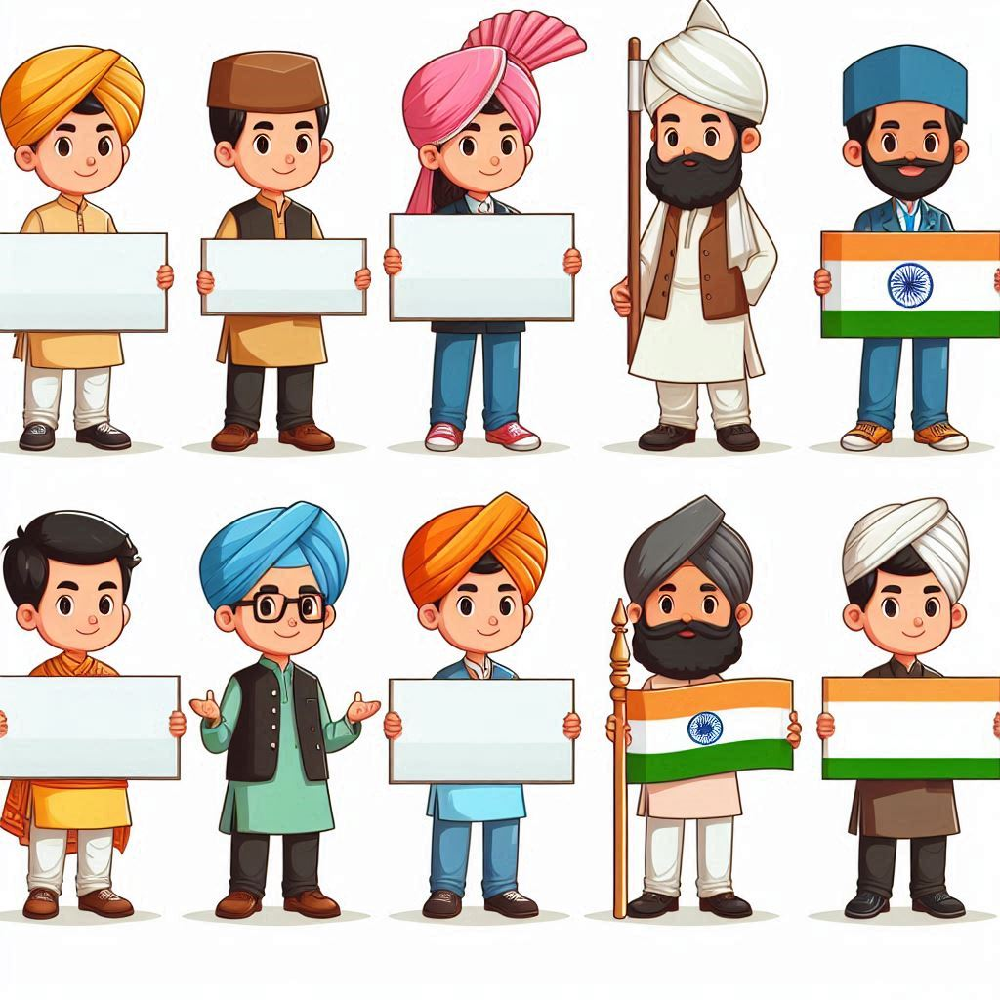

Single-Person Decision Problems
Actions
Outcomes
Payoffs
Lotteries
Language
Framework
Strategic Interactions
Action Spaces
Expected Payoff
Rational
REVIEW

Slide 4
MODULE 1 Introducing Games
TOPIC 1
The Normal-Form Representation
Modeling Strategic Interactions

Slide 5



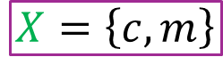

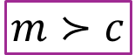
A Single-Person Decision Problem
$$A=\left\{C, M\right\}$$
Set of Actions
$$X=\left\{c, m\right\}$$
Set of Outcomes
Rational
$$m≻c$$
Go to the movies
Preference Relation
Lottery
Nature
Expected Payoff
Payoff as an ordinal construct

Slide 6

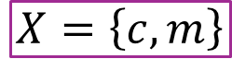
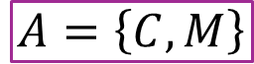
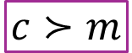
A Single-Person Decision Problem
$$A=\left\{C, M\right\}$$
Set of Actions
$$X=\left\{c, m\right\}$$
Set of Outcomes
Rational
$$c≻m$$
Go to the match
Preference Relation
Lottery
Nature
Expected Payoff
Payoff as an ordinal construct

Slide 7
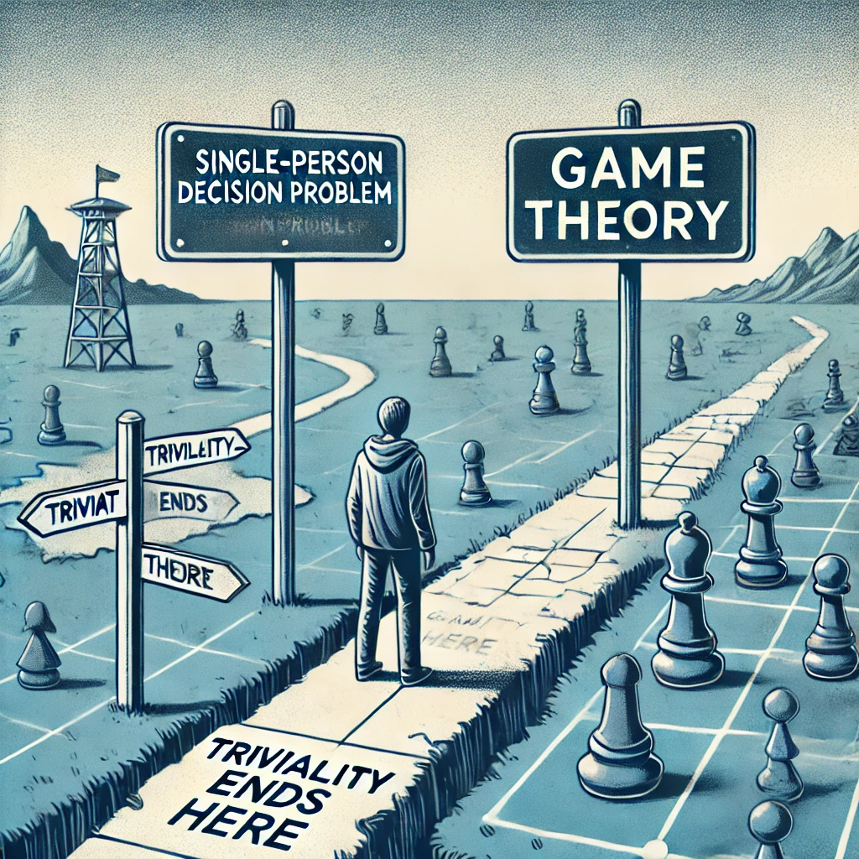


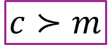
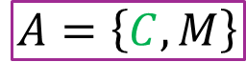


Strategic Interactions
$$A=\left\{C, M\right\}$$
$$A=\left\{C, M\right\}$$
$$m≻c$$
$$c≻m$$
Both prefer their favorite activity but value being together even more.
What happens when the two (or more) decision problems overlap?
How would our model of actions, outcomes, and payoffs change for both players?
How would we determine their best actions?

Slide 8
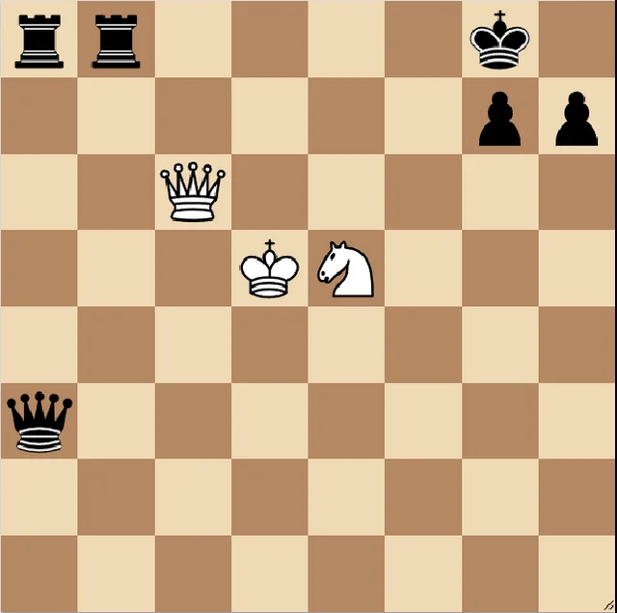
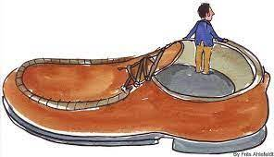

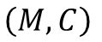
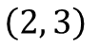
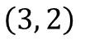
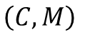
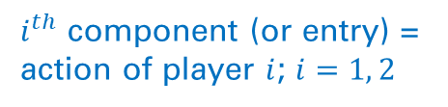
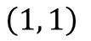
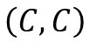
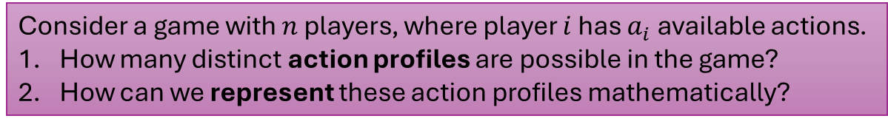
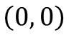
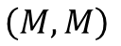
Key differences
Profiles
Complexity
Information
Strategic Thinking
Solution
Outcomes
Action Profiles
Payoff Profiles
…an ordered list of actions, one for each player, describing the combined choices of all players in the game.
…a tuple
Interaction-Induced Complexity
Action profiles: “Choices” available to players.
No single player can choose an action profile – each player chooses only one component.
…interdependence
Payoff profiles are functions of action profiles, not of individual actions.
This creates strategic interdependence and turns individual decision problems into a game.
$$A=\left\{C, M\right\}$$
$$A=\left\{C, M\right\}$$
Player 1
Player 2
Payoff profiles: Cardinal → Ordinal
$$m≻c$$
$$c≻m$$
Both prefer their favorite activity but value being together even more.
Set of
Action Profiles:
…I must consider and have information about my opponent’s ‘decision problem’
Single-person Decision Problem: “My action, my outcome, my payoff, my headache!”
Games: “My well-being depends on actions of others.”
$$\left(C, C\right)$$
$$\left(C, M\right)$$
$$\left(M, C\right)$$
$$\left(M, M\right)$$
Four ordered pairs of actions
Payoff Profiles:
$$\left(2, 3\right)$$
$$\left(0, 0\right)$$
$$\left(1, 1\right)$$
$$\left(3, 2\right)$$
Consider a game with $n$ players, where player $i$ has $a_{i}$ available actions.
How many distinct action profiles are possible in the game?
How can we represent these action profiles mathematically?
$i^{th}$ component (or entry) = action of player $i$; $i=1, 2$

Slide 9

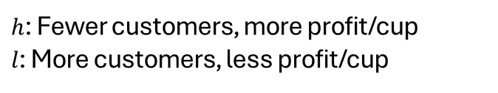
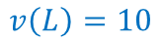
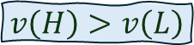
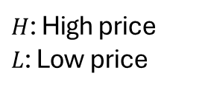
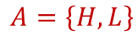
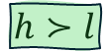
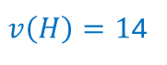
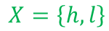
A One-Cup Problem
Decision Problem: Pick a price of each cup of coffee that maximizes profits
Actions
$$A=\left\{H, L\right\}$$
$H$: High price
$L$: Low price
Later: Continuous action spaces
Outcomes
$$X=\left\{h, l\right\}$$
$h$: Fewer customers, more profit/cup
$l$: More customers, less profit/cup
Payoffs
$$v\left(L\right)=10$$
$v\left(H\right)=1$4
Profits per day
(in thousand rupees)
$$v\left(H\right)>v\left(L\right)$$
$$h≻l$$

Slide 10

Cup Wars: Clash of the Coffee Kings

Slide 11
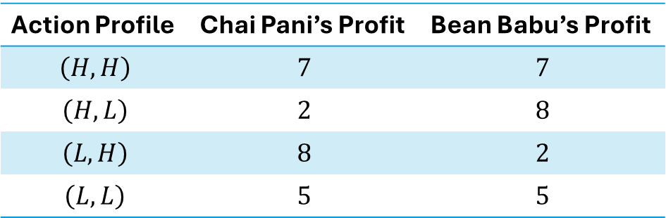
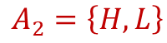
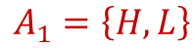
Monopoly → Duopoly
Competing for market share
Profits: market share
What pricing strategies should each café choose to maximize their profit, given that their outcomes depend on the pricing decision of the competitor?
…developing a systematic framework to analyze strategic interactions
$$A_{1}=\left\{H, L\right\}$$
$$A_{2}=\left\{H, L\right\}$$
Outcome for each café (customer traffic and profit) depends on both cafes’ actions (pricing decisions).
Payoffs
Action Profile | Chai Pani’s Profit | Bean Babu’s Profit
$$\left(H, H\right)$$ | $$7$$ | $$7$$
$$\left(H, L\right)$$ | $$2$$ | $$8$$
$$\left(L, H\right)$$ | $$8$$ | $$2$$
$$\left(L, L\right)$$ | $$5$$ | $$5$$
Moderate profits: Medium traffic at both
BB captures more of the market
CP captures more of the market
Moderate profits: Increased traffic at both
Payoffs are determined by the action profile – the combination of actions – chosen by both players.

Slide 12

MODULE 2 Static Games of Complete Information
Types of strategic interactions
Most fundamental
Later: Complex
Key principles
Most time spent
Conceptual introduction
One shot decisions

Slide 13
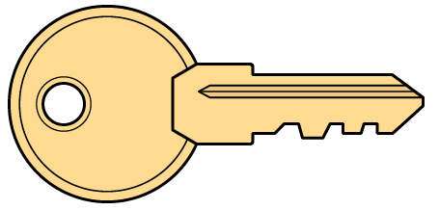

Static Games of Complete Information
…a strategic interaction between multiple players
…no time component
Step 1
Each player simultaneously and independently chooses an action once and for all.
…one decision/action/move per player
…all players make their decisions at the same time, not sequentially
…without the knowledge of what other players choose
Anticipate
Step 2
The combination of actions of all players causes the realization of an outcome after which payoffs are distributed to each player. The game ends.
…if…then…
Mr. Snack, the Lost Sailor
…not a static game
S

Slide 14
Static Games of Complete Information
…a demanding set of assumptions
A game of complete information requires that the following four components be common knowledge among all the players of the game—
Each player picks one action from her set of available actions
While picking her action, the player—
Knows the action sets of all opponents (can do)
Does not know their specific choices (will do)
All the possible actions of all the players,
All the possible outcomes,
How each combination of actions of all players (action profiles) affects which outcome will materialize,
The preferences of each and every player over outcomes (payoffs).
With complete information, each player can put herself in the opponent’s shoes and consider the game from their perspective.
By assuming the opponents are rational and fully informed, she can predict the opponent’s actions and, in turn, optimize her own action.
…solve my opponents’ decision problems

Slide 15

Common Knowledge
An event $E$ is common knowledge if (1) everyone knows $E$, and (2) everyone knows that everyone knows $E$, and so on ad infinitum.
I know that you know that I know that…

Slide 16
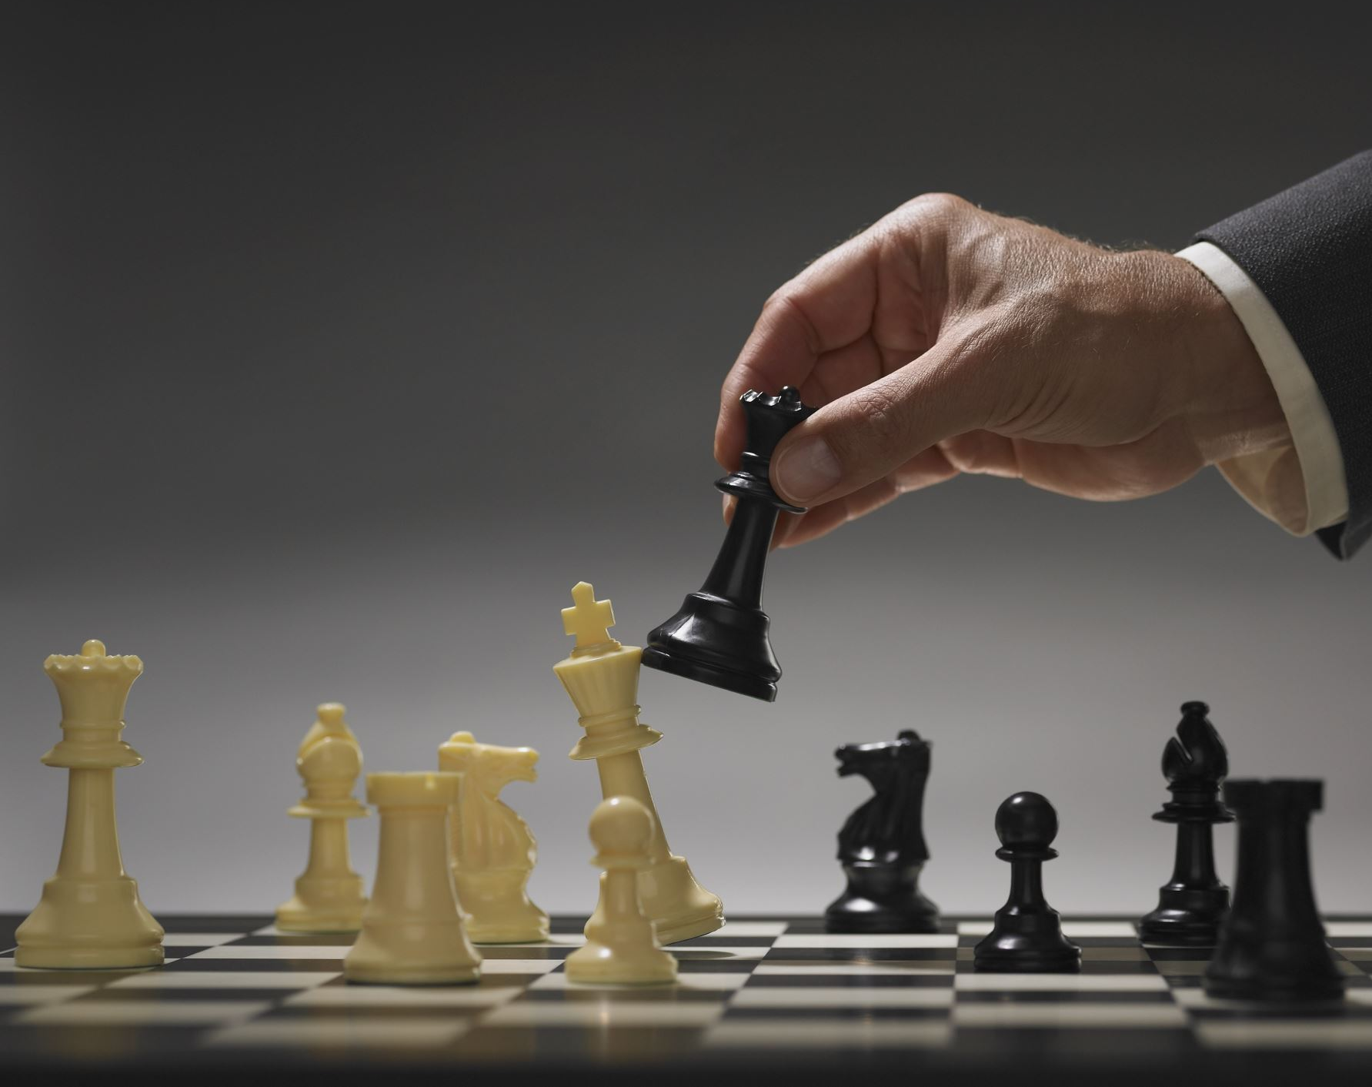
MODULE 3 A Pure Strategy
From Actions to Strategies

Slide 17

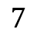
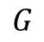
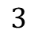
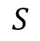

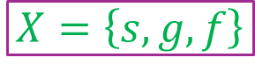

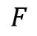
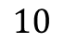
Actions
REVIEW
$$A=\left\{S, G, F\right\}$$
Action
$$10$$
Set of Actions
$$S$$
A rational choice
$$G$$
$$X=\left\{s, g, f\right\}$$
Player
$$7$$
Payoff
Set of Outcomes
$$F$$
Decision node
$$3$$
$$s≻f≻g$$
Preference Relations
Left to right
Terminal node
(Outcome)

Slide 18





Multiple Decision-Makers
Rational
REVIEW
Rational
Rational
Rational
Rational
Rational
Outcomes depend on not only our own actions but also those of other players
Rational

Slide 19

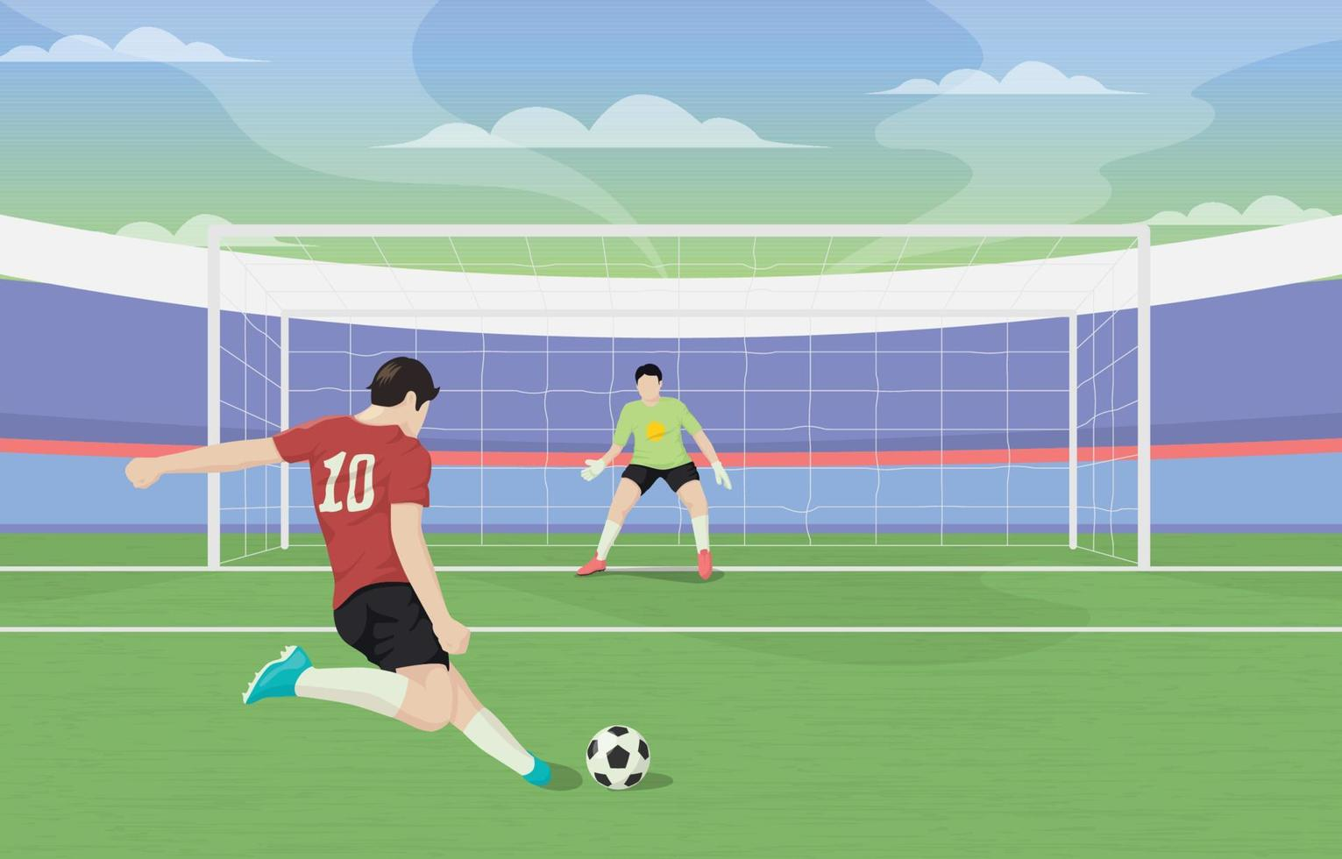

A Pure Strategy
Static games = One situation
No knowledge of others’ moves
No if-then statements
Strategy = Choosing one action
Each player’s strategy book has only one page
Mixed
A player’s choice of action for every possible situation they might face in the game
Deterministic
of
Strategies
…in general
Strategies: An exhaustive list of if-then statements
…a single complete plan of action to accomplish a specific goal
…each player’s Book of Strategies is written before the first move is played.
…from actions to strategies
…every page corresponds to a specific scenario the player might face, and on that page is written the action she will take in that situation.

Slide 20
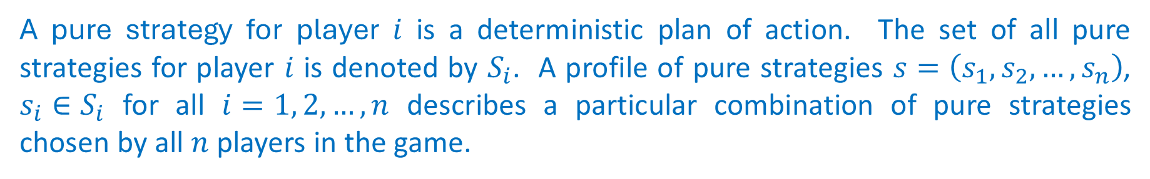
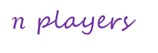

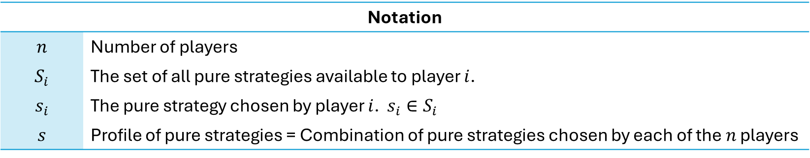
A Pure Strategy
A 100% commitment
A pure strategy for player $i$ is a deterministic plan of action. The set of all pure strategies for player $i$ is denoted by $S_{i}$. A profile of pure strategies $s=\left(s_{1},s_{2}, …, s_{n}\right)$, $s_{i}∈S_{i}$ for all $i=1, 2, …, n$ describes a particular combination of pure strategies chosen by all $n$ players in the game.
A strategy profile
A tuple with $n$ components
The pure strategy chosen by the player
$n$ players
Notation
$$n$$ | Number of players
$$S_{i}$$ | The set of all pure strategies available to player $i$.
$$s_{i}$$ | The pure strategy chosen by player $i$. $s_{i}∈S_{i}$
$$s$$ | Profile of pure strategies = Combination of pure strategies chosen by each of the $n$ players
Each player has her own set of available strategies to choose from

Slide 21

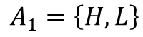
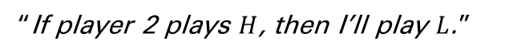
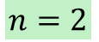
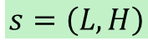
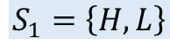





$$n=2$$
Number of players
Static games = One situation
No knowledge of others’ moves
No if-then statements
Strategy = Choosing one action
Player 1
Player 2
“If player 2 plays $H$, then I’ll play $L$.”
$$A_{1}=\left\{H, L\right\}$$
$$A_{2}=\left\{H, L\right\}$$
Both players can play one of two pure strategies—
Pure Strategy 1: Choose action $H$, charge a high price
Pure Strategy 2: Choose action $L$, charge a low price
“I’ll play L.”
Set of pure strategies available to player 1
$$S_{1}=\left\{H, L\right\}$$
$$S_{2}=\left\{H, L\right\}$$
Set of pure strategies available to player 2
Player 1 decides to charge a low price.
Player 2 decides to charge a high price.
Pure strategy chosen by player 2
$$s_{1}=L$$
$$s_{2}=H$$
Order matters
Pure strategy chosen by player 1
$$s=\left(L, H\right)$$
The chosen strategy profile

